Slide 1
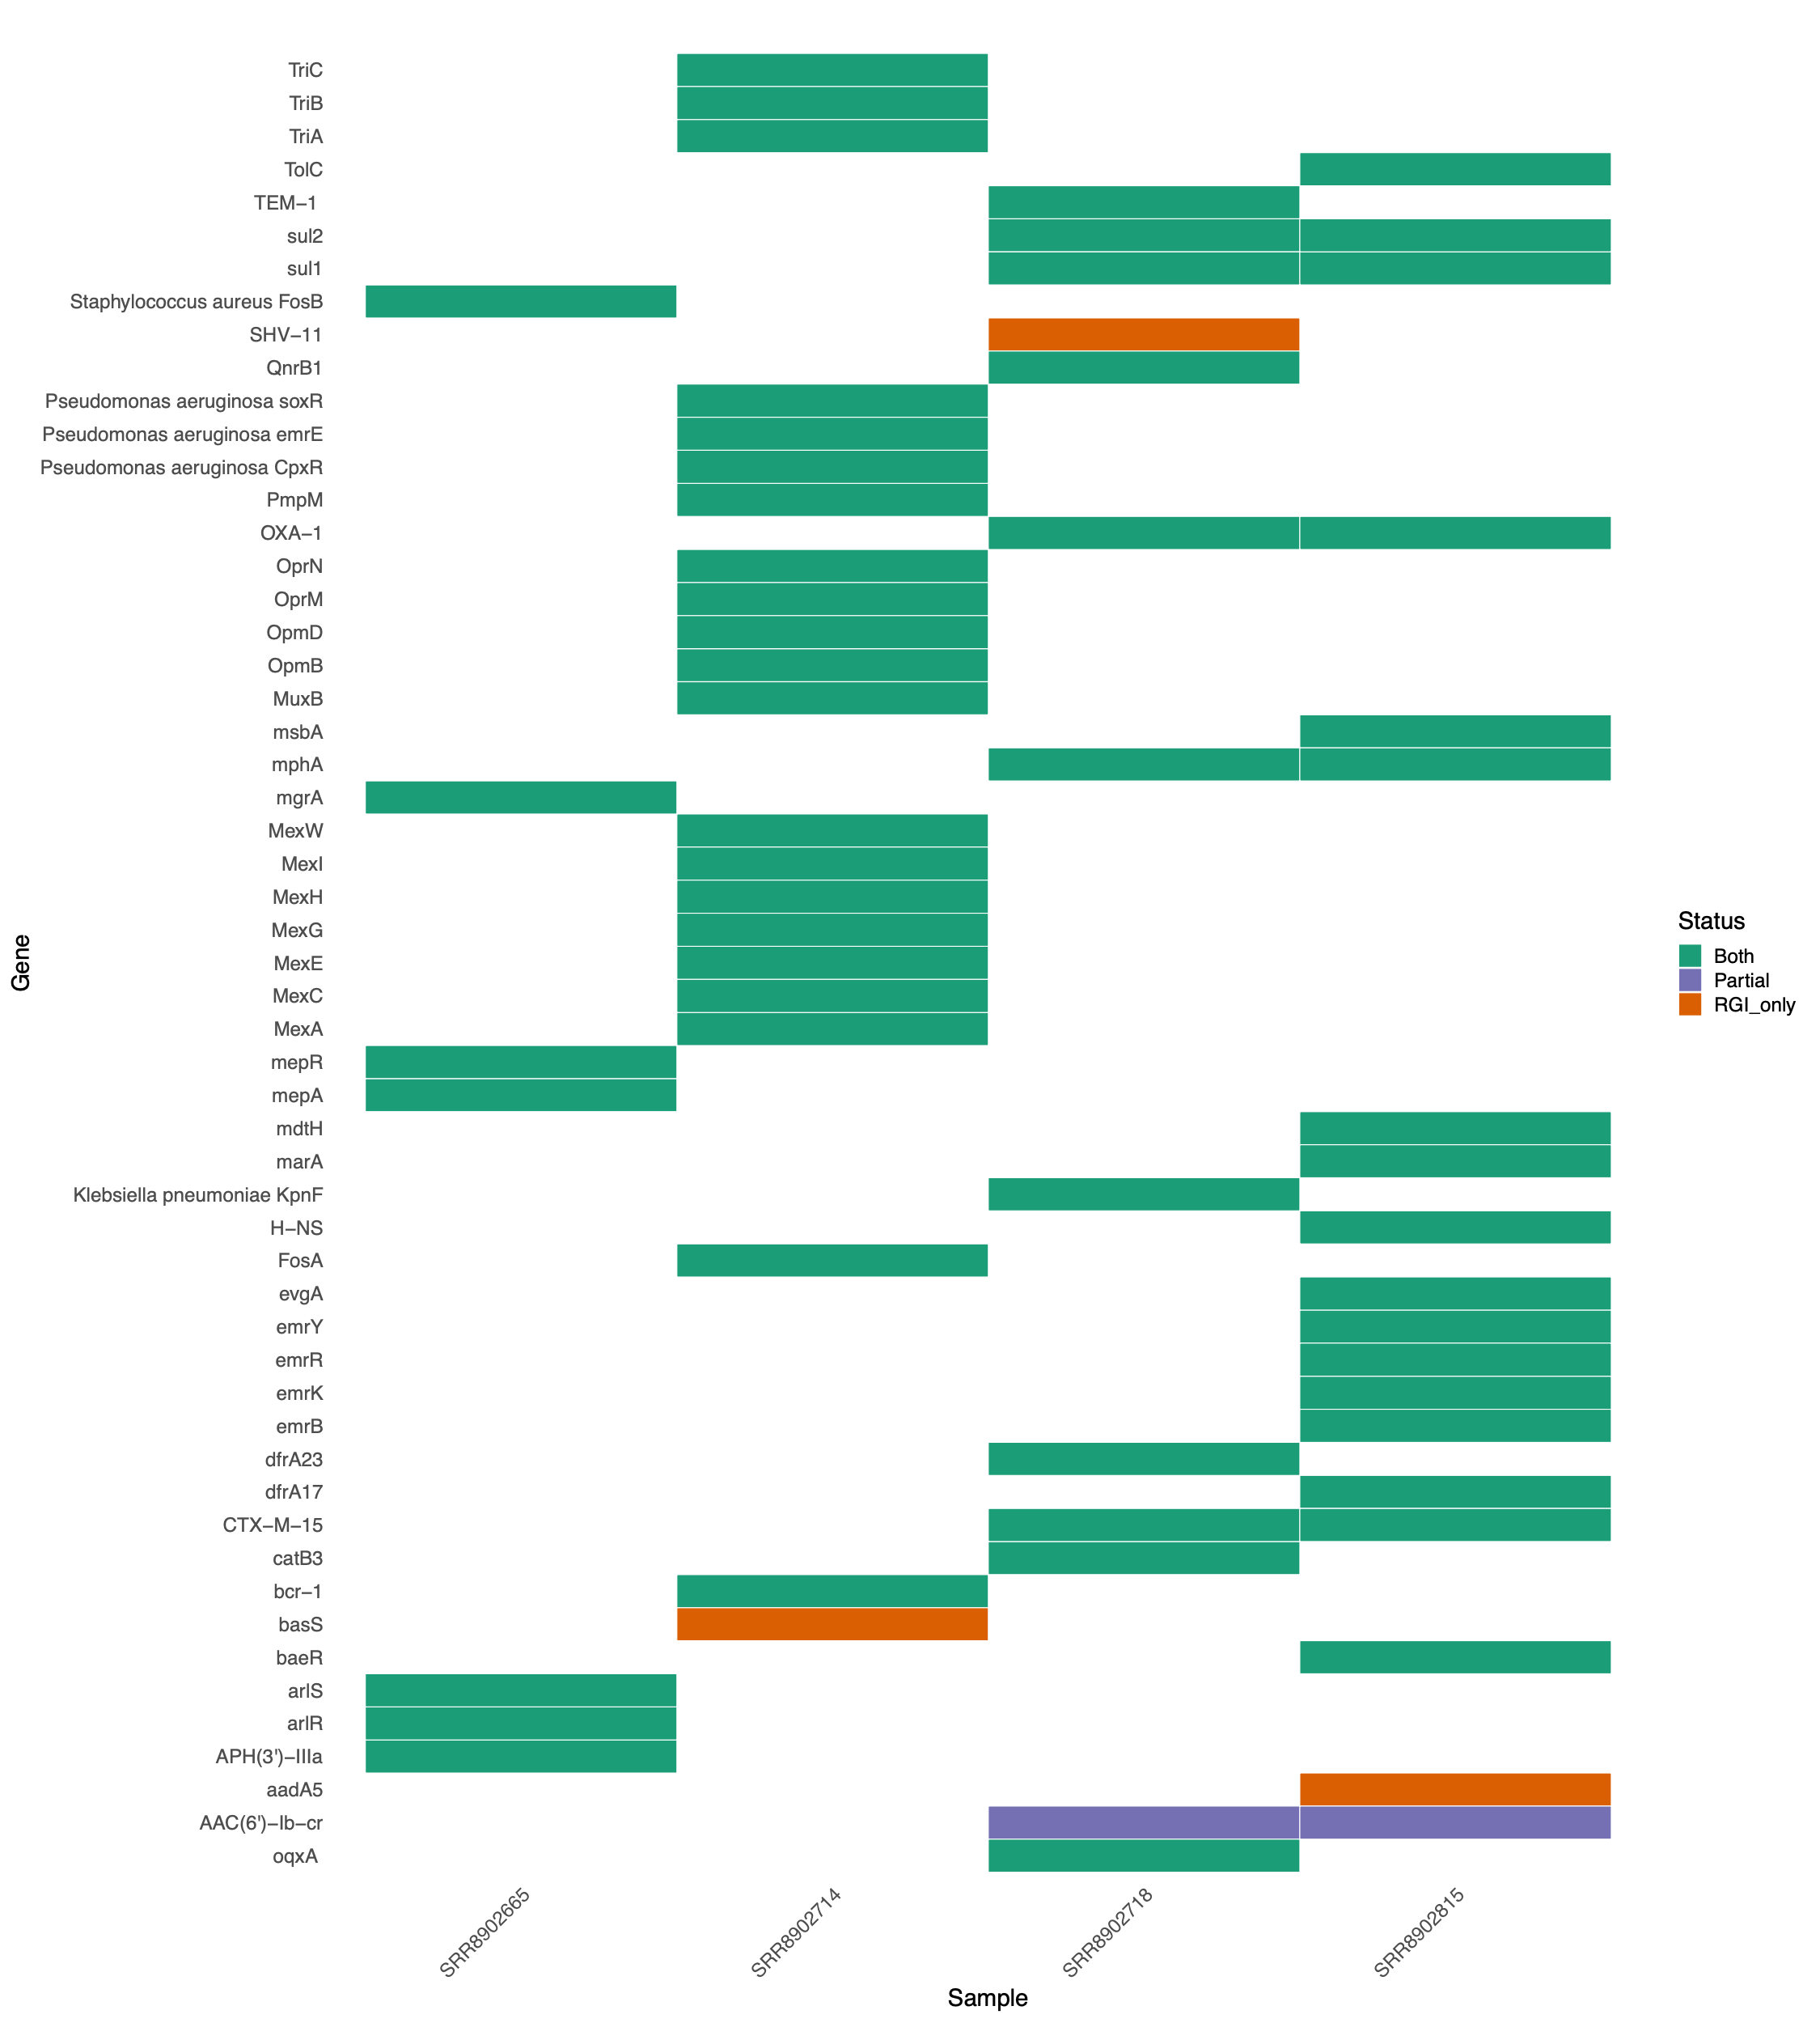

RGI bwt: A software pipeline for predicting AMR genes from raw bacterial short-read sequences
Please stop by and see my poster.
Amos R. Raphenya | Lead CARD developer McMaster University | Canada
@github.com/raphenya/wellcome-2026-rgi-bwt

